Slide 1
Current developments in DELWAQ: MacroALGae (MALG)
Rudy Schueder and Luca van Duren

Slide 2
Project - IMPAQT
Project objectives:
IMPAQT (Intelligent Management Systems for Integrated Multi-Trophic Aquaculture) is a Horizon2020 funded project aimed at developing and validating in-situ a multi-purpose, multi-sensing and multi-functional management platform for sustainable Integrated Multi-Trophic Aquaculture production
Deltares role:
Supply transport and ecological models to compute the exchange of nutrients between fish, macroalgae (kelp) and shellfish in integrated multi-trophic aquaculture sites.
Notes:
The outcome of WP3 is an integrated management system that farm operators will use on an operational basis. This system must consolidate, process, and visualize data sources such as in-situ measurements, remotely sensed images, data analytic models and numerical models in a way that provides key information and supports decision making.

Slide 3
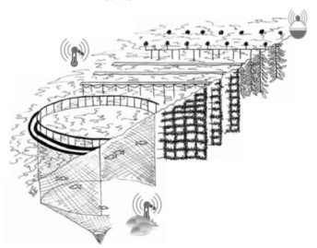
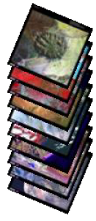
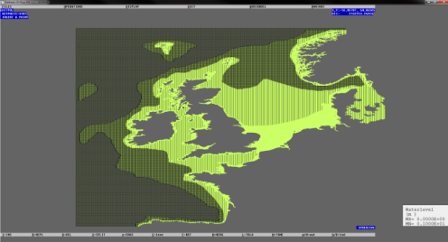
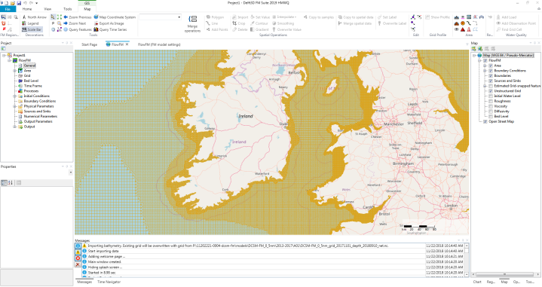
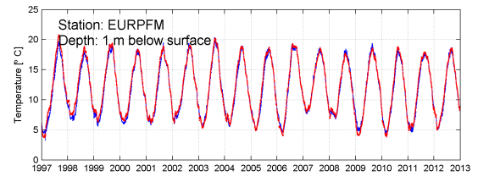
Outcome of task T3.1 – IMTA modelling for IMS
Offline
Online
Configurations
User visualization and interaction in IMS
Scenarios
Model
Data
Notes:
The model development task occurs independently of the IMS system creation (thus it is offline). In this phase of the task, data is collected about the system such as bathymetry and shoreline, about the IMTA configuration of interest, and of time varying information such as wind and ocean tides. Using this information the software will numerically solve differential equations describing exchange of water, nutrients, and biomass between the farm and the ambient conditions in a spatially resolved way. In doing so, the tool will be able to estimate, for a particular farm configuration, the net production, nutrient depletion, water levels and currents that the farm will be expected to experience. With this information optimal farm configurations can be envisioned. The model will then be run with these various configurations and the results saved to a stack of 4-D maps (3D + time). These maps are then transferred to the IMS where they can be visualized at any time by the IMS operator

Slide 4
Current Status of IMTA model
Hydrodynamics from 3D DCSM
Fish modelled as loads
DEB for shellfish
A macroalgae model
Originally thought we could use/improve submerged aquatic vegetation (SAV) module
A review of most promising literatures shows fundamental differences that are too large to introduce in an ‘update’
Thus, we write a new library taking inspiration from SAV
Notes:
Points are self explanatory

Slide 5
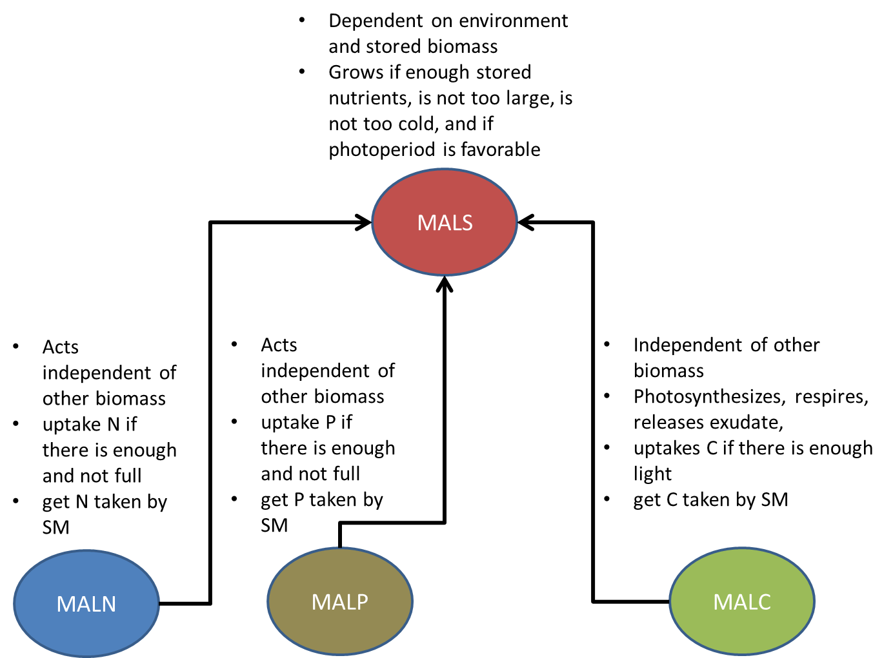
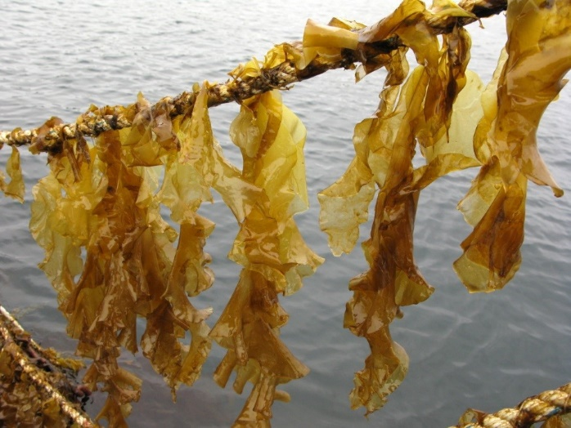
Key concepts – state variables
http://promac.no/drying-of-harvested-saccharina-latissima/

Slide 6
Key concepts – state variables
Water column
DW = 0
MALS
TIC
MALN
MALP
MALC
NO3
γ
PO4

Slide 7
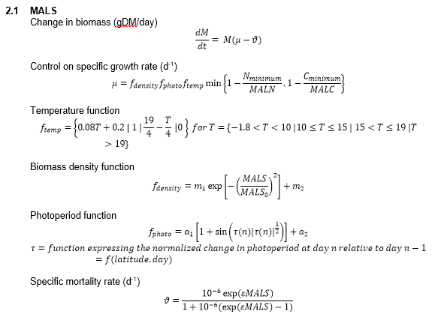
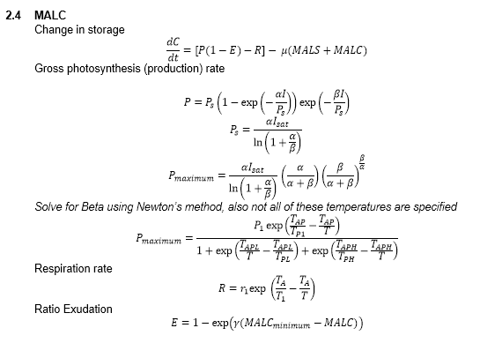
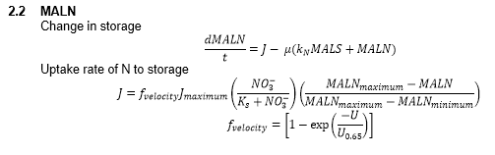
Broch et al. (2012)

Slide 8
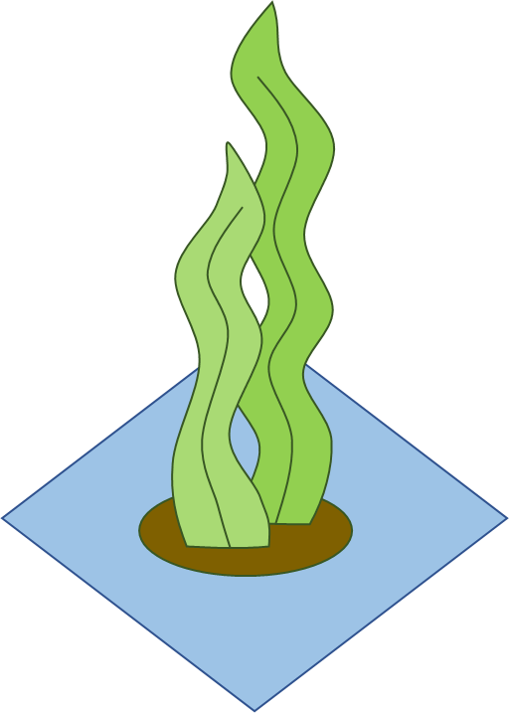
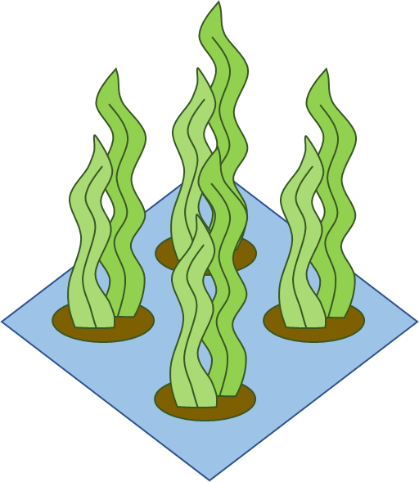
Key concepts – location in water column
Non-transportable substance, necessarily in g/m2 in DELWAQ
Grow dynamics dependent on surface area (Broch et al. (2012))
Ambient conditions experienced depends on length of frond and seeding depth
Consequence: non-unique but DELWAQ equivalent configurations with different implications for mass balance
Example 1:
High seeding density
Mass = 40g/m2
Area = 0.24 m2
Height = 0.2 m
Example 2:
Low seeding density
Mass = 40g/m2
Area = 0.24 m2
Height = 0.8 m

Slide 9

Further examples for 1 given m2
MALS = 40g/m2
TotAreaMAL= 0.67 m2
LocAreaMAL= 0.67 m2
Nfrond = 4
LinDenMAL = 50*4 = 400 g/m3
MALS0 = 0.06*4 = 0.24 m2
Height = 0.2 m
MALS = 40g/m2
TotAreaMAL = 0.67 m2
LocAreaMAL= 0.67 m2
Nfrond = 1
LinDenMAL = 50*1 = 100 g/m3
MALS0 = 0.06 * 1 = 0.06 m2
Height = 0.8 m
MALS = 40g/m2
TotAreaMAL= 2.67 m2
LocAreaMAL= 0.67 m2
Nfrond = 4
LinDenMAL = 50*4 = 400 g/m3
MALS0 = 0.06*4 = 0.24 m2
Height = 0.2 m
MALS = 40g/m2
TotAreaMAL= 2.67 m2
LocAreaMAL= 0.67 m2
Nfrond = 1
LinDenMAL = 50*1 = 100 g/m3
MALS0 = 0.06*4 = 0.24 m2
Height = 0.8 m

Slide 10
Key concepts – location in water column
How to deal with this?
User must specify 2 key parameters:
Linear density LinDenMAL (g/(m m2))
“How much mass does it take 1 m2 of a colony to grow 1 m?”
Essentially related to how densely the farmer has seeded the installation
Area density ArDenMAL (g/m2)
“How much area does the frond gain per g of growth if V/A = C (density is constant), it only grows in one direction (vertical length) and does not change shape”
Literature values available

Slide 11
Key concepts - subroutines
FLMALS.f
Computes local structural mass uptake from storage, growth respiration, produces detritus in mortality
Limited by daylength change, total size of frond (biomass density), and temperature
FLMALN.f
Computes the uptake of nutrients (NH4, NO3, PO4) from the environment
Limited by dissolved nutrient availability and current velocity
FLMALC.f
Computes photosynthetic production, maintenance respiration, exudate production
Limited by light, affected by temperature
DAYLP.f
Modification of DayL that computes rate of change of daylength at current latitude
MALDIS.f
Allocates algae mass in water column based on LinDen and g/m2

Slide 12
Progress
All subroutines have been written
Need to discuss finer details with expert to see if anything can be done “more intelligently”
Need to check to see if default parameter translations have been done correctly (Broch state variable is Frond Area, DELWAQ state variable is g/m2 water surface)
Testing!

Slide 13
Questions?

